Slide 1
Community Connect
Software Requirements Specifications (SRS)
Group 3
03 AUGUST 2023

Slide 2
PRESENTATION OUTLINE
Introduction
Overall Description
External Interface Requirements
Other Nonfunctional Requirements
Other Requirements
Use Cases

Slide 3
INTRODUCTION
Purpose
Our Community Connect platform aims to address the lack of efficiency:
community engagement
skill-sharing
emergency response
transparent donations within communities.

Slide 4
PROBLEM STATEMENT
Lack/poor community engagement.
Lack/poor emergency response.
Lack/poor transparent donations within communities.
Lack/poor skill-sharing.

Slide 5
MOTIVATION
The idea behind Community Connect originated from the recognition of the need for a centralized platform that fosters a connected and empowered community. The platform's primary goal is to create an inclusive and accessible space where community members can interact, share skills, stay informed about local events, support community initiatives, and engage in meaningful discussions. By bringing together individuals, community organizations, and moderators. Community Connect aims to enhance community cooperation and facilitate positive social impact.

Slide 6
Project Scope
The Community Connect platform is designed to create a more connected and empowered community by providing an inclusive and accessible space for :
skill-sharing.
community announcements.
emergency alerts.
secure donations.
volunteer matchmaking.
community forums.
The platform will prioritize user privacy and safety through encryption and verification mechanisms.

Slide 7
Product Perspective
The product is a new, self-contained platform known as Community Connect. It is not a follow-on member of an existing product family nor a replacement for any existing system. Instead, it is a standalone software designed to address the lack of efficient community engagement, skill-sharing, emergency response, and transparent donations within communities.

Slide 8
Product Features
The Skill Sharing Hub:
The Skill Sharing Hub is a user-friendly platform within Community Connect where community members can :
create profiles showcasing their skills.
talents.
expertise.
Users can list the skills they are willing to offer to others in the community without any monetary exchange.
Intended Purpose: The Skill Sharing Hub aims to foster a culture of altruism and mutual support within the community. It allows individuals to connect and share their knowledge, talents, and abilities, leading to skill enrichment and empowerment among community members.

Slide 9
2. Community Announcements:
Community Connect serves as a centralized hub for :
community announcements
events.
initiatives.
Users can create and promote local events, workshops, seminars, and other activities to encourage active participation and engagement within the community.
Intended Purpose: The Community Announcements feature facilitates effective communication and event coordination within the community. It helps community members stay informed about local happenings, fostering a sense of belonging and encouraging active involvement in community events.

Slide 10
3. Emergency Alert System:
The Emergency Alert System is an instant alert system integrated into the Community Connect platform. Users can send out real-time alerts to notify the entire community or specific neighborhoods during critical situations and emergencies.
Intended Purpose: The Emergency Alert System aims to ensure swift response and support during emergencies. By providing timely and accurate information, the feature enhances community safety and helps coordinate efforts to assist those in need.

Slide 11
4. Secure Donation Platform:
The Secure Donation Platform within Community Connect offers a transparent and accountable donation system for community projects and individuals in need. Users can create fundraising campaigns, and donors receive progress updates to track the impact of their contributions.
Intended Purpose: The Secure Donation Platform encourages community members to support initiatives that require financial assistance. It promotes transparency and accountability in fundraising efforts, building trust between donors and beneficiaries.

Slide 12
5. Volunteer Matchmaking:
Community organizations and projects can post opportunities for volunteers on the Community Connect platform, specifying required skills and time commitments. Users interested in volunteering can apply for relevant opportunities.
Intended Purpose: The Volunteer Matchmaking feature aims to bridge the gap between community organizations in need of volunteers and individuals willing to contribute their time and skills. It streamlines the process of finding suitable volunteers, thus supporting community initiatives efficiently.

Slide 13
6. Community Forums:
Description: Community Forums are engaging discussion boards within Community Connect that promote :
open dialogue.
idea-sharing
problem-solving among community members.
Moderators oversee the forums to maintain a respectful and supportive environment.
Intended Purpose: The Community Forums feature encourages active participation and collaboration among community members. It provides a platform for constructive discussions and exchanges of ideas, ultimately strengthening community bonds.

Slide 14
7. User Recognition and Rewards:
Active users who consistently contribute and participate in community activities on Community Connect will receive badges and points as recognition. Virtual rewards and recognition are provided within the app to motivate users to continue supporting their community.
Intended Purpose: User Recognition and Rewards incentivize community members to stay engaged and actively participate in community initiatives. By acknowledging and celebrating their contributions, this feature fosters a sense of pride and encourages ongoing involvement.

Slide 15
8. Privacy and Security:
Description: Community Connect prioritizes user data protection through encryption and secure storage. User verification is implemented to enhance the credibility of profiles and maintain a trustworthy community.
Intended Purpose: Privacy and Security are paramount in Community Connect to build user trust and ensure the safety of personal information. By employing robust security measures, the platform aims to provide a secure and reliable space for community members to interact and engage.

Slide 16
User Classes and Characteristics
The primary user classes of the platform are:
Community Members: Individuals residing in a community who can create profiles, offer their skills, and participate in community activities.
Community Organizations: Groups or organizations within a community that can post volunteer opportunities and community initiatives.
Moderators: Users responsible for overseeing and maintaining a respectful and supportive environment in the community forums.

Slide 17
Community Members:
Community members are individuals who reside in the community served by the Community Connect platform.
They may belong to various age groups, professions, and backgrounds, contributing to the diverse and inclusive nature of the community.
Community members may have different skill sets and expertise that they are willing to offer to others.
Roles:
Profile Creators: Community members can create profiles on the platform showcasing their skills, talents, and areas of expertise.
Skill Sharers: They can freely offer their services to others in the community without any monetary exchange, fostering a culture of altruism and mutual support.
Event Participants: Community members can actively participate in local events, workshops, seminars, and other community activities promoted on the platform.
Volunteers: They have the option to apply for volunteer opportunities posted by community organizations and contribute their time and skills to community projects

Slide 18
Community Organizations:
Community organizations are groups or entities operating within the community, such as non-profit organizations, local clubs, or charitable institutions.
They have specific goals and initiatives aimed at addressing community needs and fostering positive change.
Community organizations may require volunteers or financial support to carry out their projects successfully.
Roles:
Opportunity Posters: Community organizations can post opportunities for volunteers on the platform, specifying the required skills and time commitments for each opportunity.
Initiative Promoters: They can promote community initiatives and events to reach a broader audience and encourage active participation from community members.
Donation Recipients: Community organizations may be eligible to create fundraising campaigns on the Secure Donation Platform to receive financial support for their projects.

Slide 19
3. Moderators (Chief of the Community):
Moderators are designated users responsible for overseeing and maintaining the respectful and supportive environment of the Community Forums.
They possess good communication skills and are impartial in addressing discussions and conflicts that may arise in the forums.
Moderators are committed to upholding community guidelines and ensuring a positive user experience for all participants.
Roles:
Forum Managers: Moderators monitor and manage the Community Forums to ensure that discussions are constructive, relevant, and adhere to community guidelines.
Conflict Resolution: They are tasked with resolving any disputes or conflicts that may arise between community members in the forum discussions.
User Support: Moderators may also aid users who have questions or issues related to the platform's features or functionalities.

Slide 20
Operating Environment
Android Devices:
The software exclusively runs on Android devices.
including smartphones and tablets Android OS.
The software is compatible with Android operating systems.
from a specific version 5.0 upward.
The application is developed using the Java programming language.
It will be available on Google Play Store.
Firebase database

Slide 21
Design and Implementation Constraints
Hardware Limitations.
Third-Party Integrations:
Platform Compatibility:
Parallel Operations:

Slide 22
User Documentation
User Manual.
Community Guidelines.
Accessibility Information.
Privacy Policy and Data Protection.
Terms of Service.

Slide 23
Assumptions and Dependencies
Internet Connectivity:
The platform assumes that users will have access to stable and reliable internet connectivity to interact with the mobile app interfaces. Limited or unreliable internet access may affect user engagement and real-time interactions.
User Conduct:
The project assumes that users will adhere to the platform's code of conduct, maintaining respectful and inclusive interactions within the community forums. In case of misuse or violations, moderators will take appropriate actions, but complete adherence to conduct guidelines is assumed for a supportive community environment.
Dependencies:
User Participation:
The success of the Community Connect platform is dependent on community members actively participating in the platform, creating events, volunteering, and engaging in discussions.

Slide 24
System Features
User Registration and Authentication.
Community Announcements
Emergency Alert System
Secure Donation Platform
Volunteer Matchmaking

Slide 25
External Interface Requirements
Software Components for User Interface:
Community Member Dashboard
Event Creation and Management
Volunteer Opportunities
Community Forums
Emergency Alert System
Donation and Fundraising
User Profile and Recognition
Community Organization Interface:
Moderator Tools:
Hardware Interfaces
Touch Screen Interface
Android Devices

Slide 26
Other Nonfunctional Requirements
Performance Requirements
Safety Requirements

Slide 27
Other Requirements
SRS: Software Requirements Specification - A document that outlines the requirements and functionalities of the software being developed.
Android OS: The operating system used for Android devices, on which Community Connect will run.
API: Application Programming Interface - A set of rules and protocols that allows different software applications to communicate with each other.
SDK: Software Development Kit - A collection of software tools and libraries used to develop applications for a specific platform.
IDE: Integrated Development Environment - A software suite that provides tools for coding, testing, and debugging software applications.
Compatibility: The ability of the software to work effectively with various devices, operating systems, and other software components.
Privacy Policy: A document outlining how user data will be collected, used, and protected on the platform.
Terms of Service: A document specifying the terms and conditions governing the use of the platform by users.
Release Notes: Documentation highlighting updates, bug fixes, and new features introduced in each software release.

Slide 28
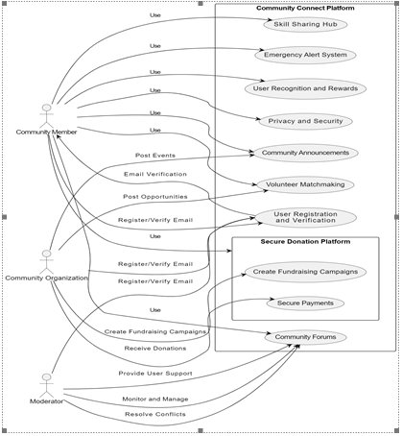
USE CASE DIAGRAM

Slide 29
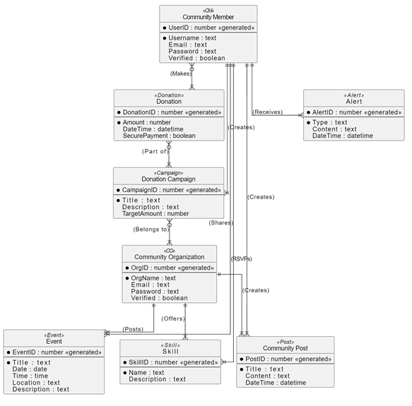

Slide 30
References
Wiegers, K. & Beatty, J. (Year). "Software Requirements." Microsoft Press. ISBN: 978-0735679665.
Pohl, K. & Rupp, C. (Year). "Requirements Engineering: Fundamentals, Principles, and Techniques." Springer. ISBN: 978-3642155657.
Jackson, M. (Year). "Software Requirements and Specifications: A Lexicon of Practice, Principles and Prejudices." Addison-Wesley Professional. ISBN: 978-0321104191.
van Lamsweerde, A. (Year). "Requirements Engineering: From System Goals to UML Models to Software Specifications." Wiley. ISBN: 978-0470847475.
Cockburn, A. (Year). "Writing Effective Use Cases." Addison-Wesley Professional. ISBN: 978-0201702255.
Robertson, S. & Robertson, J. (Year). "Mastering the Requirements Process: Getting Requirements Right." Addison-Wesley Professional. ISBN: 978-0321815743.

Slide 31



THANK YOU
GROUP 03
COMMUNITY CONNECT
SRS

